Slide 1
Biped Robot DESIGN
PROJECT BY : Bin7ashi

Slide 2
Project Overview
This project is about Biped robot which has structure similar to human legs.
The BIPED will perform tasks like walking forward and backward and turning to the left and right.
The Biped Robot has 6 degrees of freedom, 3 for each leg.(HIP, KNEE, and ANKLE)
The Biped will avoid obstacle by walking backward and then turning to the left or right
the Biped works automatically depending on the input code program.

Slide 3
Requirements & tasks
Tasks:
Creating a design for the Biped Robot.
Making the programming code for walking forward and backward and turning to left and right.
Interfacing the Ultrasonic sensor and the motors.
Writing a program for avoiding the obstacle
Modifying the code to establish a smoother walking sequence for the Biped Robot.
Requirements:
Arduino Uno R3 , Arduino sensor shield.
Servo motors (MG996R)
Materials to build the Biped robot.

Slide 4
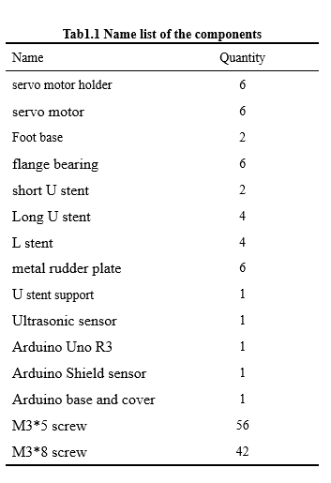
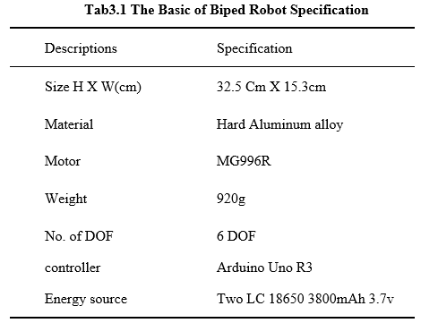

Slide 5
Design

Slide 6
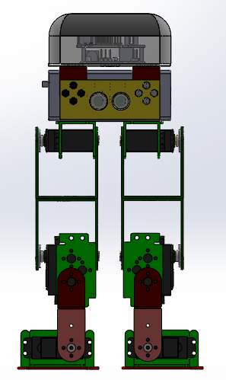
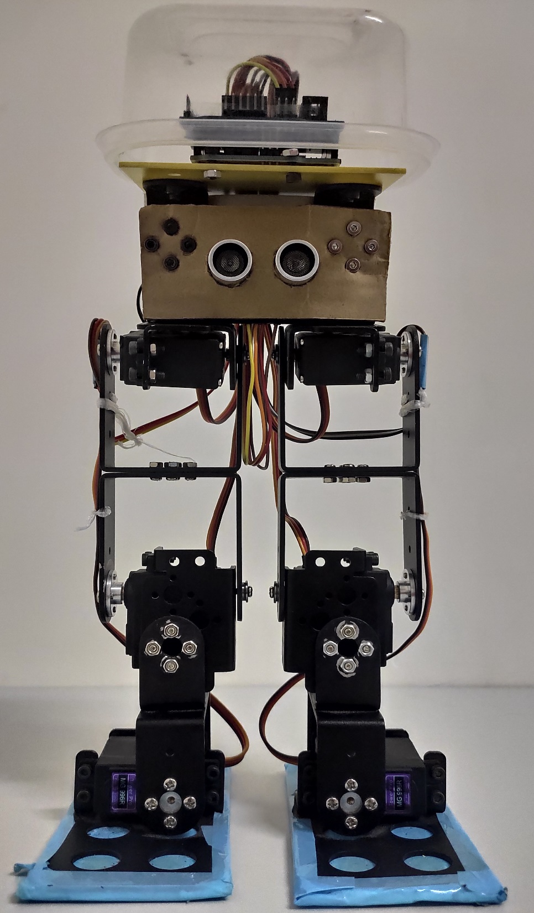

Slide 7
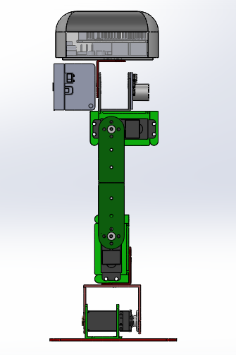
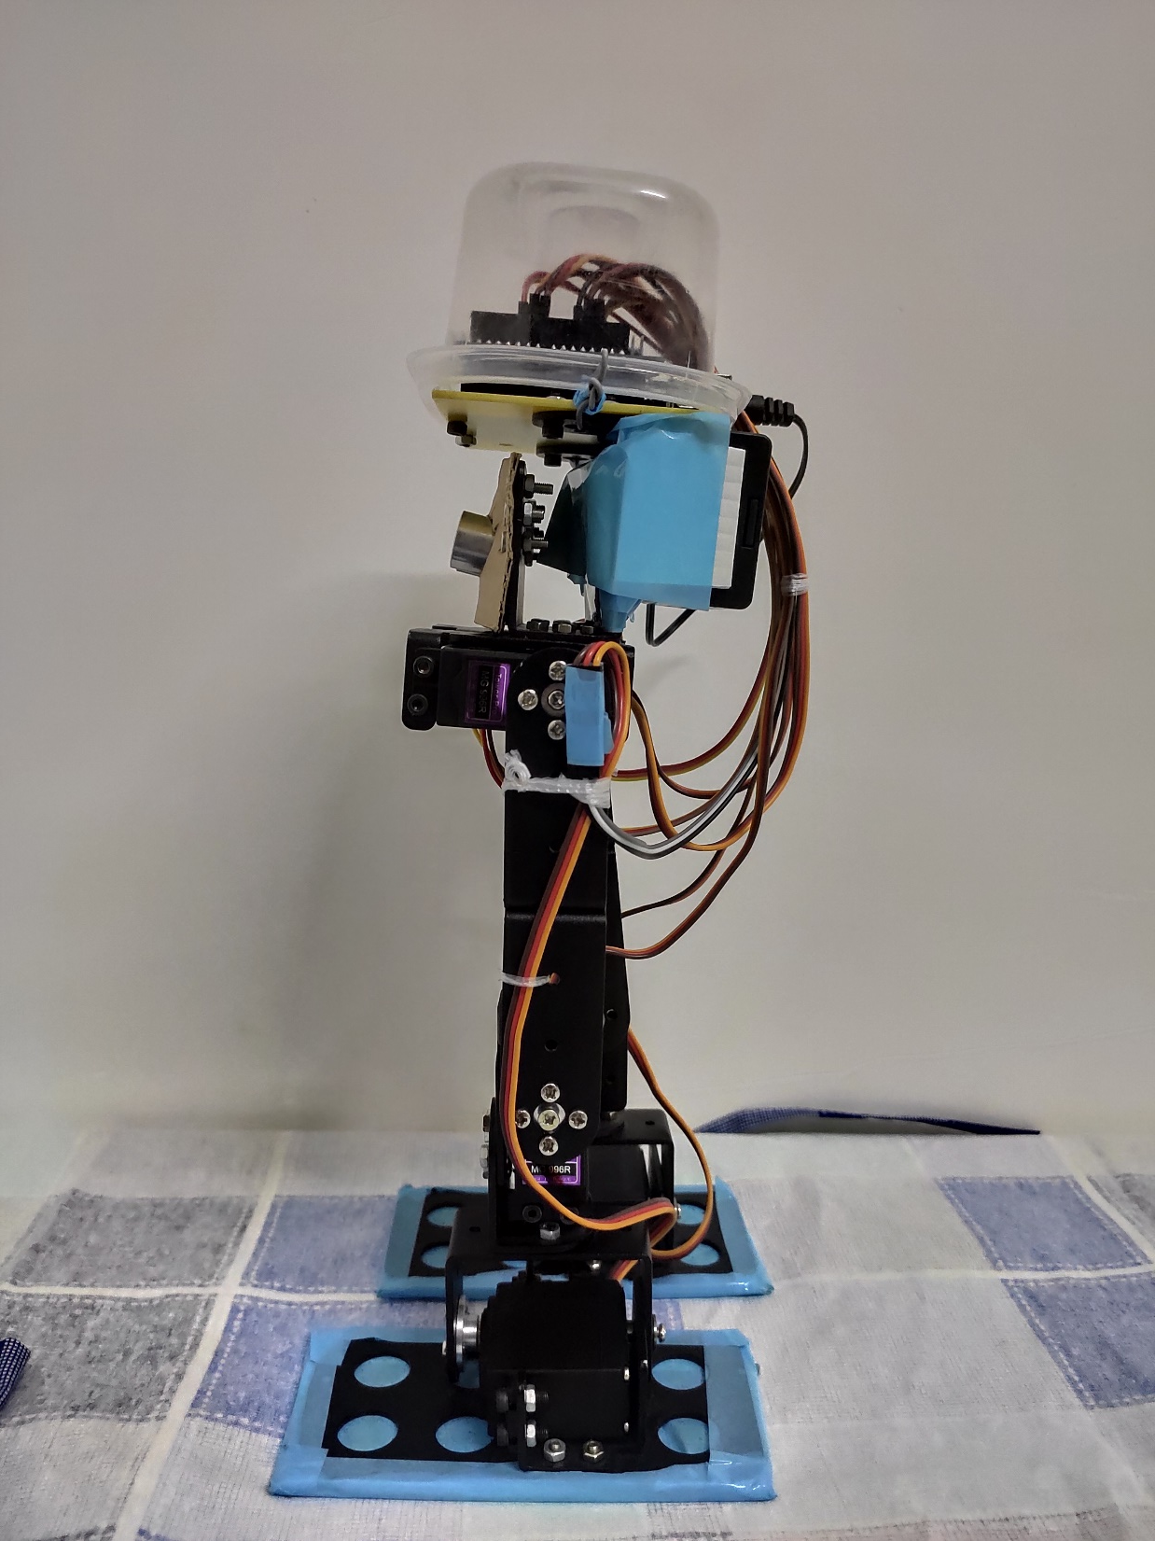

Slide 8
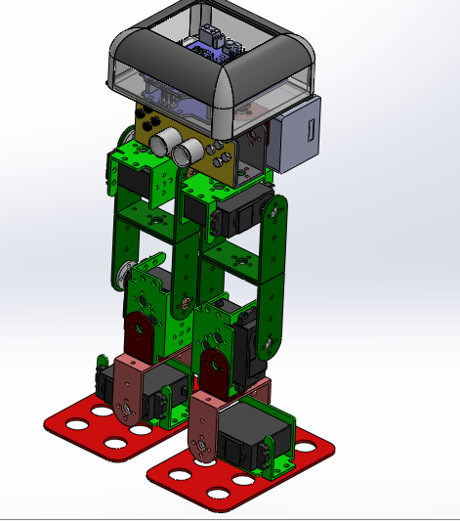
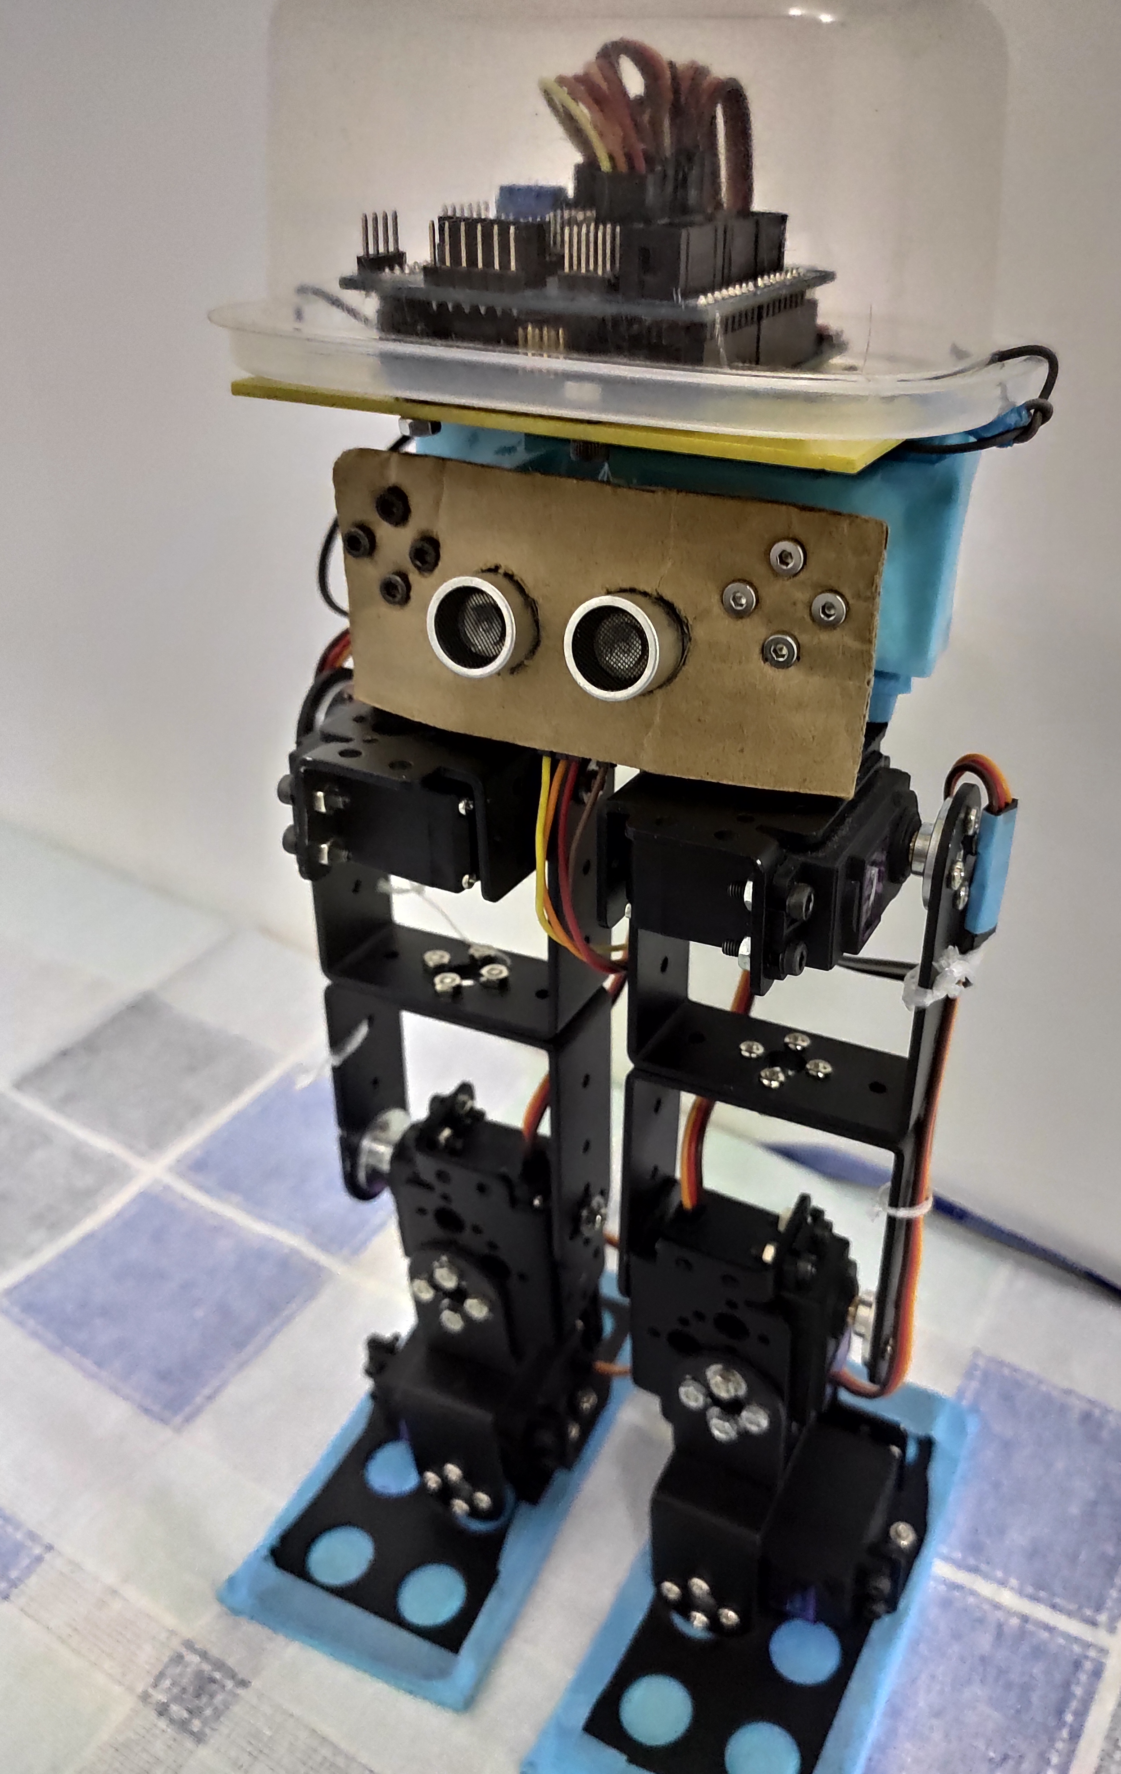

Slide 9
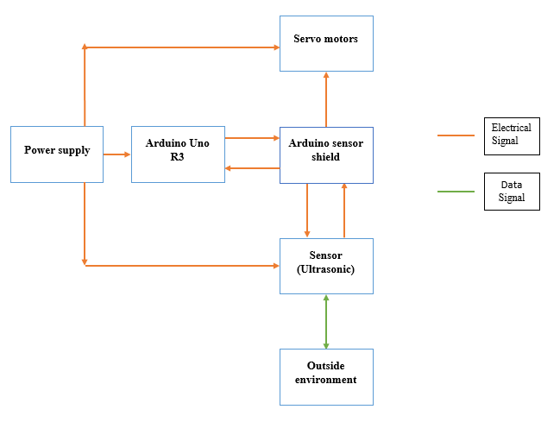
Block diagram

Slide 10
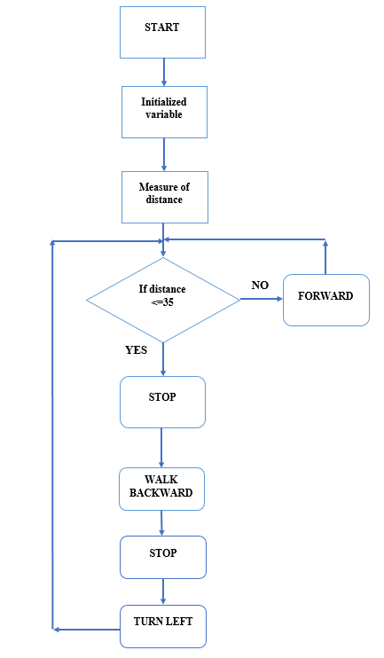
Flow Chart

Slide 11
The two version of Turing left and turning right
In the first version of turning left and right the biped robot will use only four servo motors instead of six servo motors which is the two hips servo motors and the two knees servo motors.
In second version of turning left and right the biped robot will use only two servo motors instead of six servo motors which is the Ankles servo motors.

Slide 12
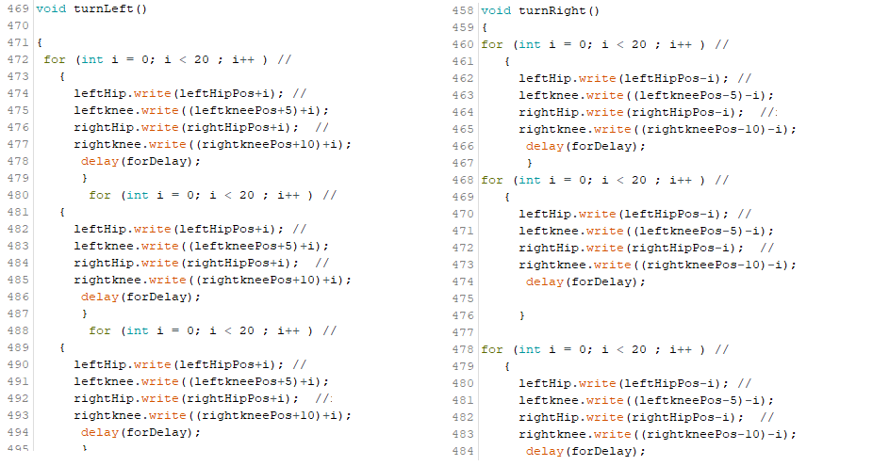
First version of Turning left and Right

Slide 13
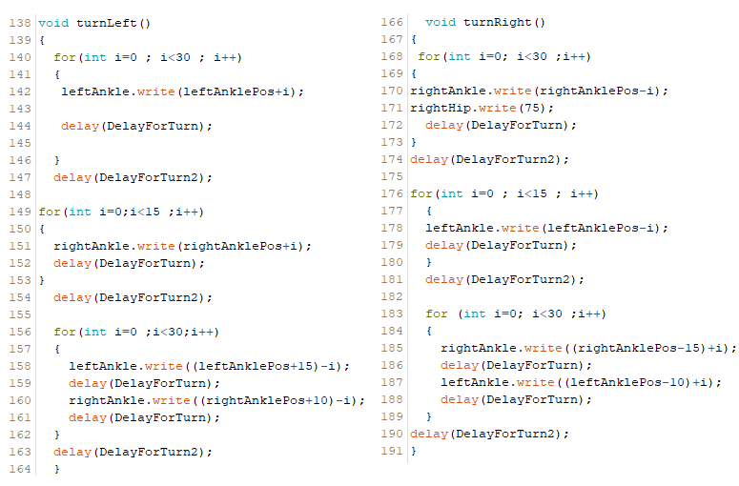
Second version of Turning left and Right

Slide 14
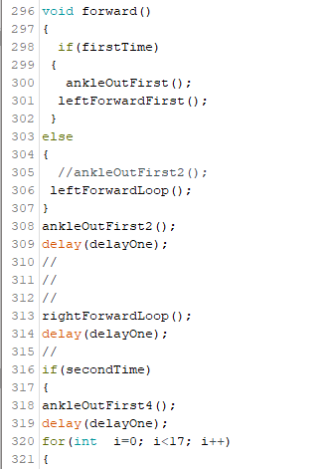
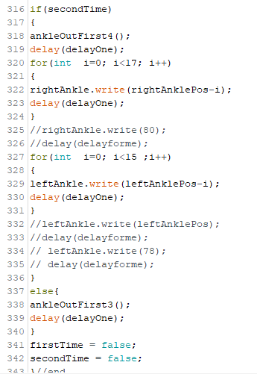
Forward Movement

Slide 15
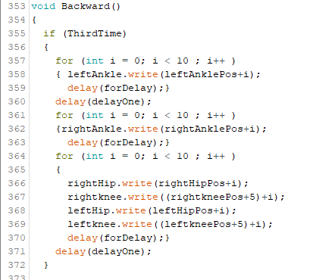
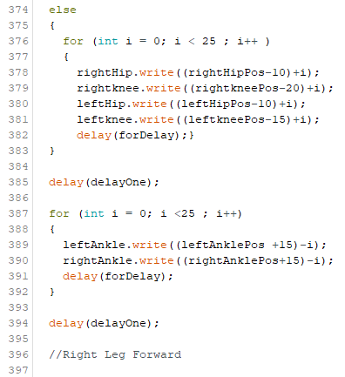
Backward Movement

Slide 16
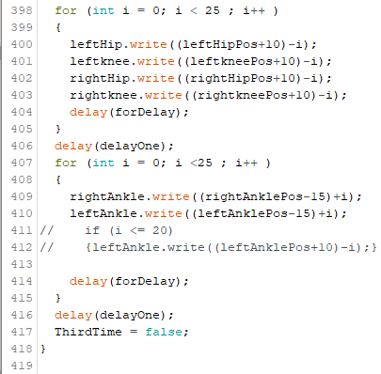

Slide 17
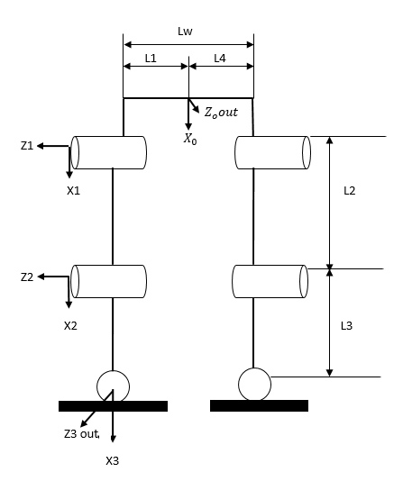
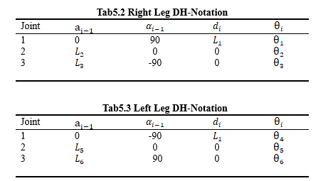
D-H parameters
In order to simplify motion analysis of a robot, different frames are attached to every joint.
The method of assigning these frames is D-H method and it yields for different parameters.
Frame offset, Frame rotation, Frame twist, and link length.

Slide 18
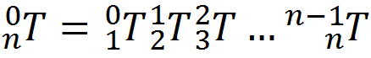
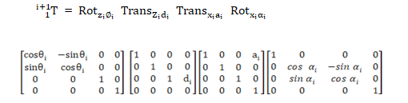
Forward
Given the full set of joint variables, The pos of the end effector of the robot can be calculated.
Using D-H parameters, a transformation matrix can be constructed.

Slide 19
Thank You
For Question >>>
Alisodal1997@gmail.com

